Slide 1
Continental Glaciers
Greenland
Lake Bonney in Antarctica

Slide 2
Continental Glaciers
When valley glaciers no longer confine to river valleys and spread out to create large ice sheets known as continental glaciers.
Cover flat, lowland regions.
Advance as a result of valley pushing the sheet forward.
Notes:
Move very slowly and advance as a result of valley glaciers advancing and pushing the sheet forward. Leave behind scoured bedrock and hilly deposits of debris. When glaciers retreat they can leave behind rich deposits of soil and many lakes. Antarctica is covered with ice an average of 2,133 meters (7,000 feet) thick. If all of the Antarctic ice melted, sea levels around the world would rise about 61 meters

Slide 3
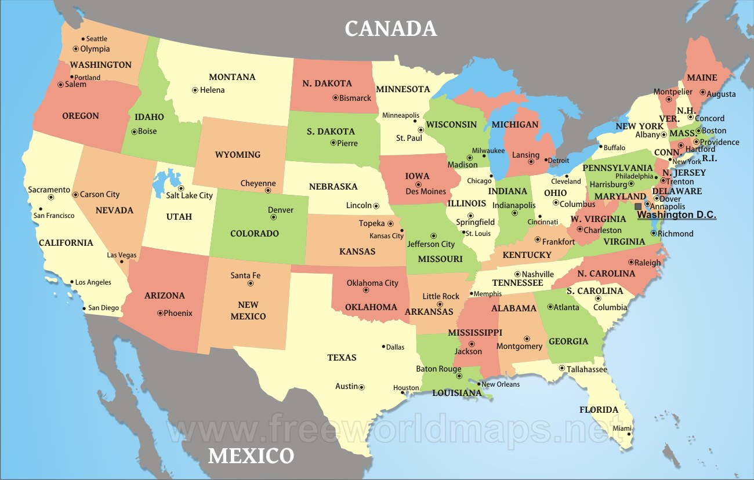

Slide 4
Surface Features: Lakes
Glacial Ponding:
water body formed by glacial meltwater after glacier retreats.
The water pools in a depression created by erosion and debris or ice can block the flow of water.

Slide 5
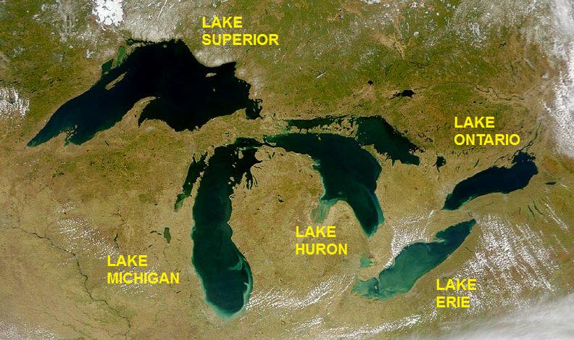
The great Lakes
Notes:
retreat of the ice sheet left behind a large amount of meltwater (see Lake Agassiz) that filled up the basins that the glaciers had carved, thus creating the Great Lakes as we know them today. Ice 2 miles thick. Gouged lake basins → meltwater filled these basins.

Slide 6
http://www.canadiangeographic.ca/magazine/ja13/alacarte.asp#

Slide 7
Lakes
a) Finger lakes

Slide 8
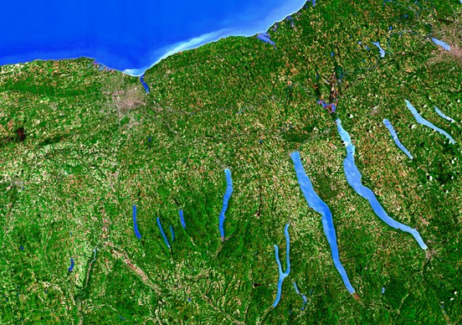

Slide 9
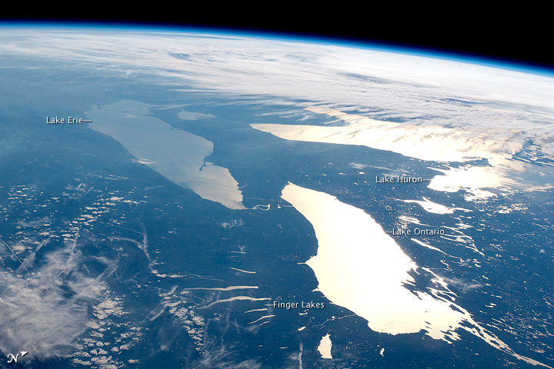

Slide 10
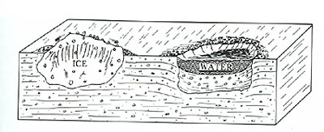
Lakes
B) Kettle Lakes
Notes:
depressions left behind after partially-buried ice blocks melt. Many are filled with water, and are then called "kettle lakes. Kettle lake basins were formed as the glaciers receded. While this was happening, a block of ice broke off the glacier, and just sat there. As the glacier continued to melt, the debris from the glacier (soil, rocks, stones, gravel, etc.) filled in around the block of ice

Slide 11
Notes:
Northwest Territory, Canada

Slide 12
Glacial debris
Continental glaciers retreated as temperatures warmed, the ice was carrying its maximum load and dropped off the eroded material.
Glacial till

Slide 13
Outwash plain
Large plain of debris
Formed as water carries deposits once held in layers of ice.
Notes:
Seperated by streams of meltwater

Slide 14
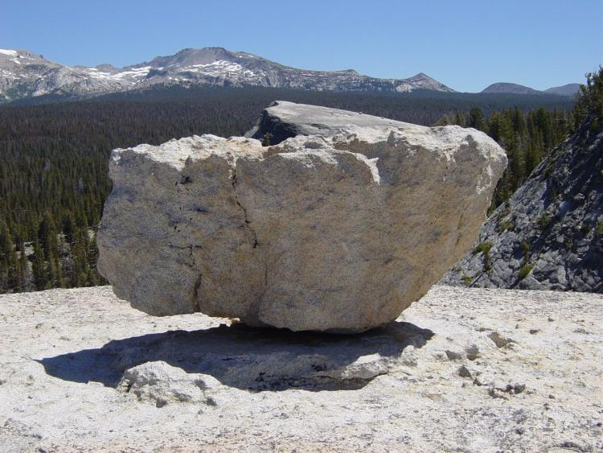
Glacial Erratics

Slide 15
Drumlins

Slide 16
Eskers

