Slide 1
Wind Erosion and Landforms of Desert Areas
Unit 5: Gradational Processes
Ms. Thind

Slide 2
desertification
Notes:
Affecting 168 countries worldwide.

Slide 4
http://revisionworld.com/gcse-revision/geography/development/case-studies/case-study-sahel-desertification

Slide 6
The desert
: an area in which the annual rainfall is not sufficient to maintain a continuous cover of vegetation.
: wind has an opportunity to play a major part in the creation of desert landforms.
Notes:
Since there is lack of rainfall → little erosion by the action of water → wind plays a key role in the creation of the desert.

Slide 7
Why…
few plants to anchor the debris and little vegetation to restrict air movements = winds of the desert are able to whip up rock fragments and carry them → formation of distinct landforms.

Slide 8
Where are the worlds deserts?
Sahara Desert
Arabian Desert
Gobi Desert
Syrian Desert
Great Basin Desert
Patagonian Desert
Kalahari Desert
Great Victorian Desert
Label the following 8 deserts on your map.

Slide 9
Deserts of the world
COC
Equator
COC
COC

Slide 11
Deserts and wind action
Strong winds carry light surface materials are carried by suspension.
Movement of sand in the desert is largely by saltation: particles roll and bounce along the ground.

Slide 12
Moving sand can have an abrasive power on existing landforms.
Strongest close to the ground and create features called toadstools.
Notes:
Mushroom shaped rocks.

Slide 13
deflation
Refers to wind blowing away sand, silt and clay in deserts so that underlying rocks become exposed.
The resulting landforms are deep hollows called blowouts and stony landscapes called Badlands.

Slide 14
Notes:
Blowout: roots of plants become exposed. Sedimentary rock and clay rich soil that has been exposed due to water and wind erosion.

Slide 15
Sand Dunes
Notes:
Sand dunes are an effective wind break. Mounds of loose sand, piled up by wind movements.

Slide 16
Dune Formation
Winds carry sand over the desert landscape → deposits of sand collect on some obstruction → over time a sand dune will take shape.
Long, gentle slope on windward side and steep slope on leeward side → slip face.
Notes:
Dune migration: wind carries sand over the windward side by saltation and the individual grains of sand accumulate on the slip face → causing the dunes to move.

Slide 17
Dune migration

Slide 18
Barchans
- Crescent shaped
- Forms over small boulder
- Horns point downwind
- Sand blows up the windward slope and slides down the slip face
Notes:
Found in rockier environments with much less vegetation

Slide 19
Transverse Dunes
- Abundant sand needed
- Continuous sand ridge forms at right angles to wind
Notes:
When there is enough sand, barchan sand dunes join together to form long ridges of sand.

Slide 20
parabolic
- Crescent shaped
- Horns point up wind
- Vegetation anchors the horns
Notes:
Found close to beaches, anchored by vegetation, most common type. Strong winds.

Slide 21
Longitudinal dunes
Found in deserts where only a thin layer of sand is present
- Winds blow continuously in one direction
- Long and straight parallel to the wind
Notes:
Largest type of dune, parallel to the primary wind direction. Require strong winds in order to create such straight lines.

Slide 22
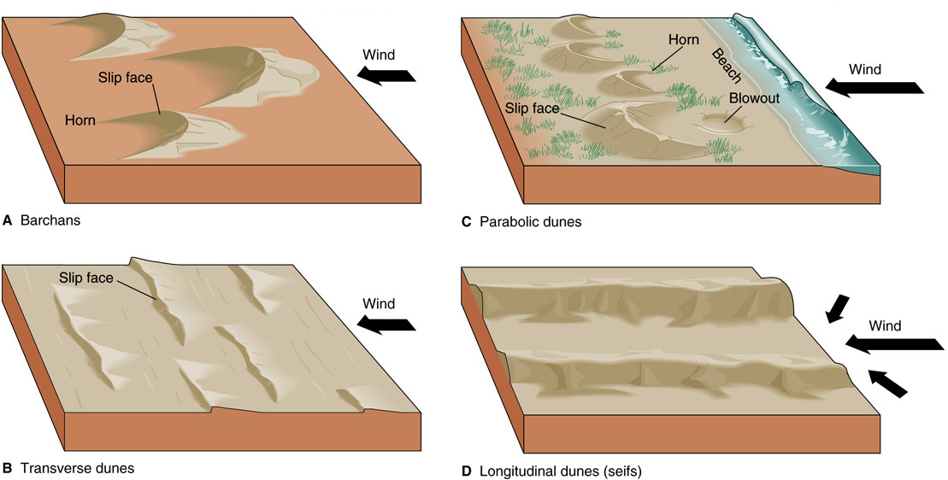

Slide 23
Unique Landforms
Alluvial Fans
Playa lakes
Canyons
Plateau
Buttes
Mesa
Ergs

