Slide 1
Wave Action and Coastal Landforms
Unit 2: Gradational Processes

Slide 3
http://www.youtube.com/watch?v=ITv6gSUmTjc

Slide 4
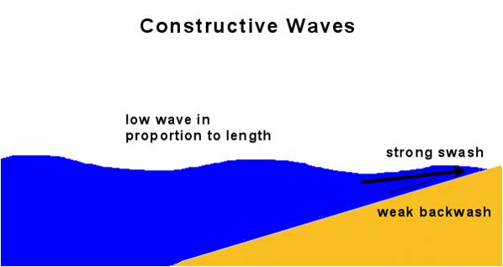
Wave Action
constructive or spilling waves:
- waves that hit gentle sloping beaches
- begin their breaking motion far from the shore
- they build the beach
Notes:
Coastline is impacted by two different types of waves. 1. constructive and destructive waves. These waves break a considerable distance from the shore and expend their energy before hitting the beach. Swash is stronger than the backwash → deposition or construction of the beach.

Slide 5
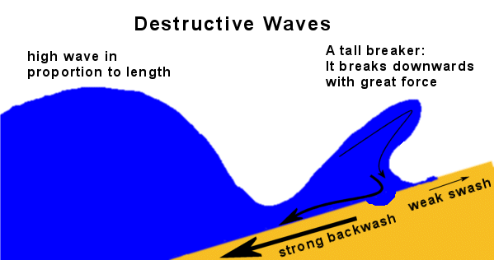
Wave Action
destructive or plunging waves
- waves that strike steep sloping beaches
- breaking motion begins close to shore
- sand is dragged back into the ocean
Notes:
Swash: sand driven onto the beach by a wave. Backwash: water returning to the beach. Backwash is stronger than the swash → destruction.

Slide 6
Longshore Drift
Refers the zigzag movement of sand along the beach.
Notes:
https://www.youtube.com/watch?v=f-Z8FwDLQL8.
Waves approach the shoreline on an angle → sand is driven up, washed away, driven up, and washed away again → moves in a horizontal fashion.
Wind currents will determine the direction of the wave as it approaches land. Waves approach on an angle → material moves in zigzag fashion. Sand gets pushed in (swash) and gravity will bring water back (backwash).

Slide 8
Erosional action by waves
Notes:
Corrosion: material absorbed by the salt content in water
Abrasion: sediment (sand) carried in water can wear down rock surfaces.
Attrition: rock particles striking each other and fracture.
Hydraulic Action: wind generated waves strike shoreline going into cracks of rock and widening gaps.
What erosional action would need fast moving water? Hydraulic action.

Slide 9
Hydraulic Action and Undercutting
Notes:
Undercutting: occurs at base of cliffs → rock is worn down by hydraulic action → can result in a mass wasting event, cliffs will retreat. Erosional action along shorelines occurs at the base of the cliff.
Rock is cracked and worn down by hydraulic action
Process called undercutting creating steep and vertical cliffs
Cliffs begin to retreat → decrease stability → cliff can collapse

Slide 12
Cliff Retreat

Slide 13
https://www.youtube.com/watch?v=2fS2Swi0q-U

Slide 14
Depositional Features: created when sand, silt, and clay is carried by ocean currents
Notes:
Sand spit: sand, silt, and clay eroded from the cliffs carried by longshore drift ocean current → long ridge of sand. Can threaten entrance to harbours.
Tombolo: sand spit grows long enough ridge of sand joining an island

Slide 15
Groynes

Slide 16
Groynes

