Slide 1
Structures of the Earth’s Surface

Slide 2
Extrusive vs. Intrusive
Extrusive Forms: when magma flows out onto the surface it is said to extrude → structures are called extrusive forms.
Intrusive Forms: magma that penetrates the lithosphere and does not reach the surface. It solidifies in cracks → intrudes upon overlying rocks → structures are intrusive forms.

Slide 3
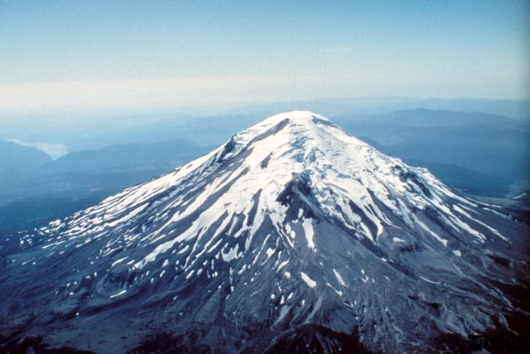
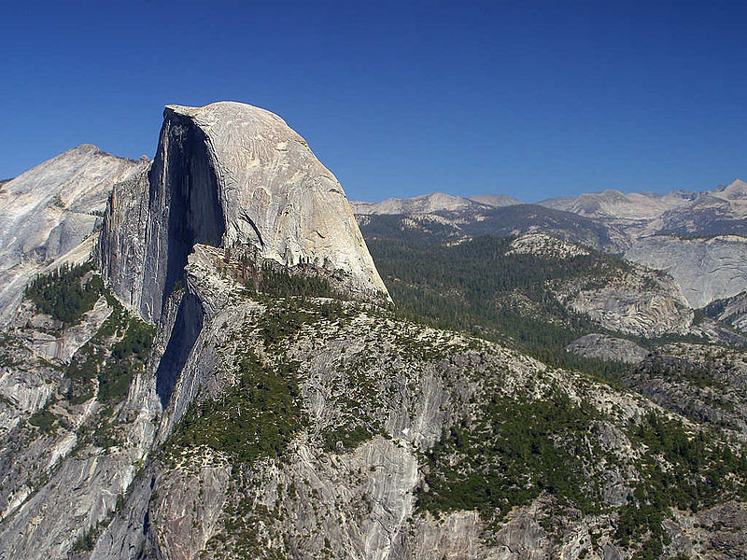
Extrusive: magma cools quickly at surface
Intrusive: magma cools slowly at depth
Notes:
Composite cone volcano: example of extrusive feature and Yosemite half dome.

Slide 4
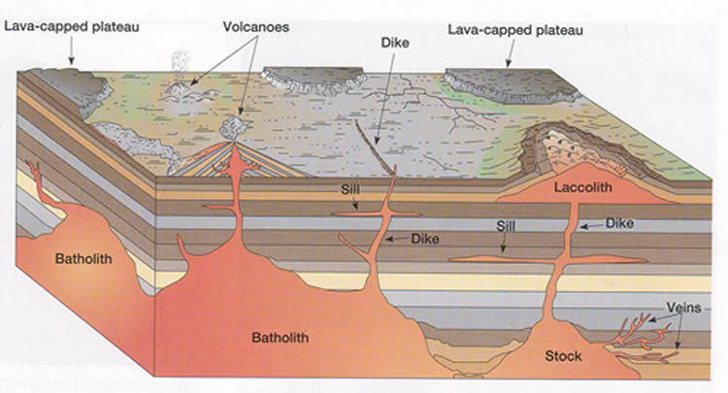
Batholith, sill, dike, laccolith, stock

Slide 6
http://www.youtube.com/watch?v=Nboq5zsLxFE

Slide 7
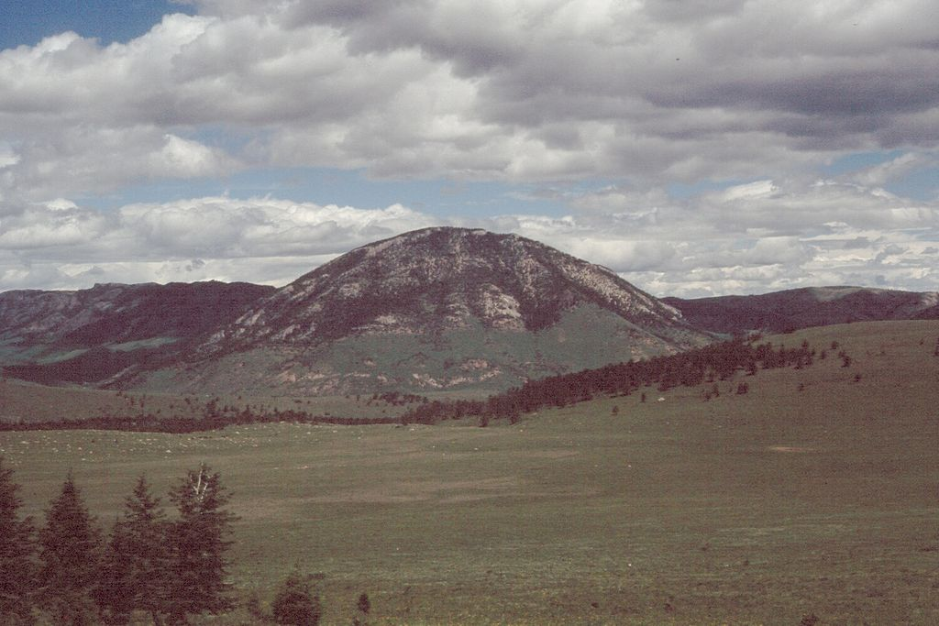
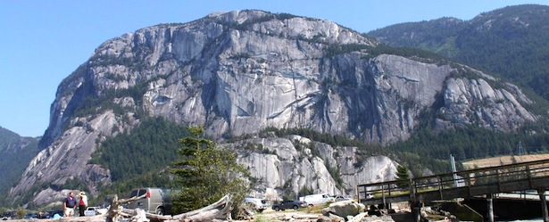
Notes:
Laccolith: in Montana, exposed due by erosion by the layers of rock that once covered it. The Chief in squamish is a batholith, dike that runs right through the middle, it is not in a straight line→ indicates plate activity, long straiations indicate glacial erosion.

Slide 8
Deformation of the earth’s surface
How are features on the earth’s surface shaped and reshaped?
Notes:
Formation of mountains is a direct result of plate activity, fold mountains are formed when 2 plates move together (divergent boundary). The movement forces a series of folds and faults on the rock.

Slide 9
Faulting and Folding
Forces of compression (pushing together) and tension (pulling apart) play a role in the folding and faulting of rock layers.
Upfolds → anticlines
Downfolds → synclines
Notes:
Faulting: rocks under tremendous pressure or tension fracture under strain. If movement takes place along a fracture → faulting takes place. Folding is the dominant process in the formation of mountain ranges → fold mountains. When tectonic plates collide and squeeze together

Slide 11
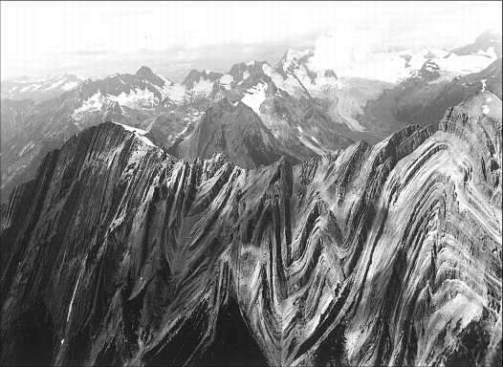
Notes:
Folded mountains are the product of two inter continental (continent-continent) plate collisions. Example: Appalachians, Himalayas, Rocky Mountains, Alps

Slide 12
Landforms produced by faulting:
Normal Fault (tension)
Reverse Fault (compression)
Rift Valley or Graben (tension)
Block Mountain or Horst (compression and or tension)

Slide 14
Notes:
Graben located along the east flank of the Paradox Valley anticline.

