Slide 1
Running Water
Unit 4: Gradational Processes
Ms. Thind

Slide 2
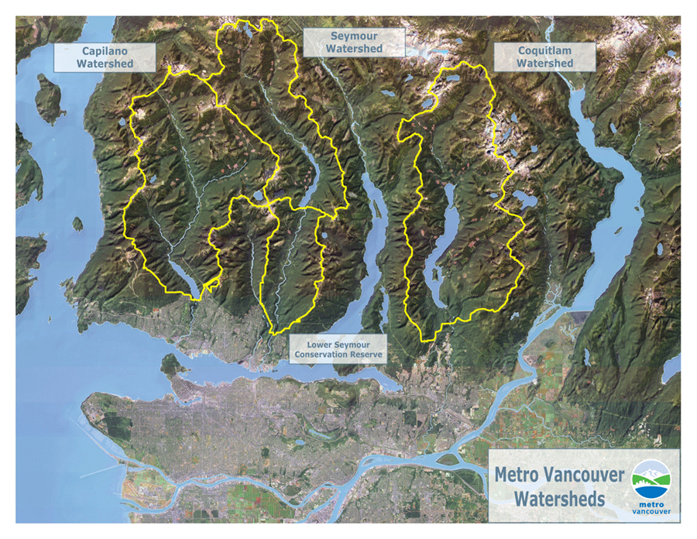
Notes:
three protected watersheds to provide 2.3 million residents with a clean, reliable and affordable supply of drinking water.

Slide 3
River Anatomy
Notes:
Upper Course: young stages of river development. V shaped valley, erosion, turbulent water, rapids, waterfalls. Middle Course: vertical erosion, lateral erosion begins, water slows and deposition of material Lower Course: rover begins to widen, depositional features.

Slide 5
Erosional action by rivers
Hydraulic action:
Force of water has great power.
Material is worked loose from banks and river bed then carried downstream and deposited in lower regions where water flow diminishes.
Greater the velocity the greater the erosion
Abrasion:
Debris and sand have an abrasive effect on river banks and river beds.
Rocks look polished by the abrasive power of the river’s load.

Slide 6
Erosional action by rivers
Attrition:
When water moves fast, rocks of varying sizes are moved along by the river and they repeatedly strike other rocks → breakup of rock into smaller pieces.
Corrosion:
Rivers are mildly acidic and some rocks are dissolved in water and transported.

Slide 7
Transporting Sediment:
Notes:
Suspension: clay particles are light and will be carried. Solution: anything that is dissolved and carried away → water may be crystal clear but water has soluble minerals. Saltation: particles are too heavy, move around by bouncing and rolling alon → key in how materials move downstream. Tractopm: drag along floor → move during spring runoff when velocity is greatest.

Slide 8
https://www.youtube.com/watch?v=izHmK578rzE
https://www.youtube.com/watch?v=OsrHjo2AcgI

