Slide 1
Running Water 2

Slide 2
What erosional and depositional features are found at the different stages of river development?

Slide 3
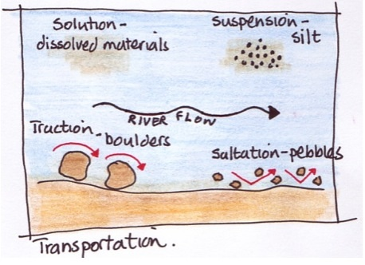

Slide 4
Youth Stage (upper course)
Vertical erosion is the river’s main work at this stage.
River cuts a deep V-shaped valley or canyon via hydraulic action and corrosion
As river moves downstream the banks are susceptible to freeze –thaw action.
Notes:
Rivers are dominated by erosion as turbulent water allows little deposition to occur. Freeze thaw action: rocks will loosen and get carried downstream.
https://www.youtube.com/watch?v=FIn0UoeDyVg

Slide 5
Youth Stage
Notes:
Rapids are areas along the rivers course where water becomes more turbulent, often creating white water which rafters love. It is caused by increase in gradient along the rivers gradient or where the river flows over alternating bands of harder and softer rocks.

Slide 6
Potholes
Notes:
River water swirls around rocks along river bed, rocks get swept in small depressions and abrade the hollow → process continues and creates a pothotle.

Slide 7
Waterfalls
Notes:
The river flows over bands of softer and harder rocks. Softer rock is more quickly eroded. The river undercuts the harder rock leaving an overhang. The river forms a plunge pool below the waterfall. Overhanging rock is unsupported and falls into the plunge pool. The waterfall is moved upstream. This process continues and a gorge is cut back into the hillside.

Slide 8
Mature Stage (middle course)
Vertical erosion continues + downstream lateral erosion of banks.
Velocity of flow slows and deposition of river sediment is common.
Speed of river slows and can be used as a transportation route.
Notes:
Definite drainage pattern evident in watershed. Speed of river slows and can be used as a transportation route

Slide 9
Mature Stage
Meanders: river slows, lateral erosion begins to take place and river starts to wind.
Point of erosion: cut bank
Point of deposition: point bar or slip-off slope
Notes:
River slows, lateral erosion begins to take place and river starts to wind.

Slide 10
Old Age Stage (lower course)
Large, slow moving stream on flat land.
Flood plain and meanders continue to widen.
Slow moving river is forced to deposit its load. Usually along the flood plain → alluvium.
Notes:
River delta is well developed and can continue to grow each year as sediment is flushed down from the highland regions. Alluvium: deposits by a river.

Slide 11
Old Age
Levees
As river overflows its banks, it deposits material → natural levees form along the banks.
Flat flood plain ideal for farming but subject to flooding → artificial levees built to prevent flooding damage.
Notes:
develop along river banks as materials get deposited by flooding.

Slide 12
Old Age
Meanders and Oxbow Lakes
As meanders widen the river can cut across meanders to create oxbow lakes.

Slide 13
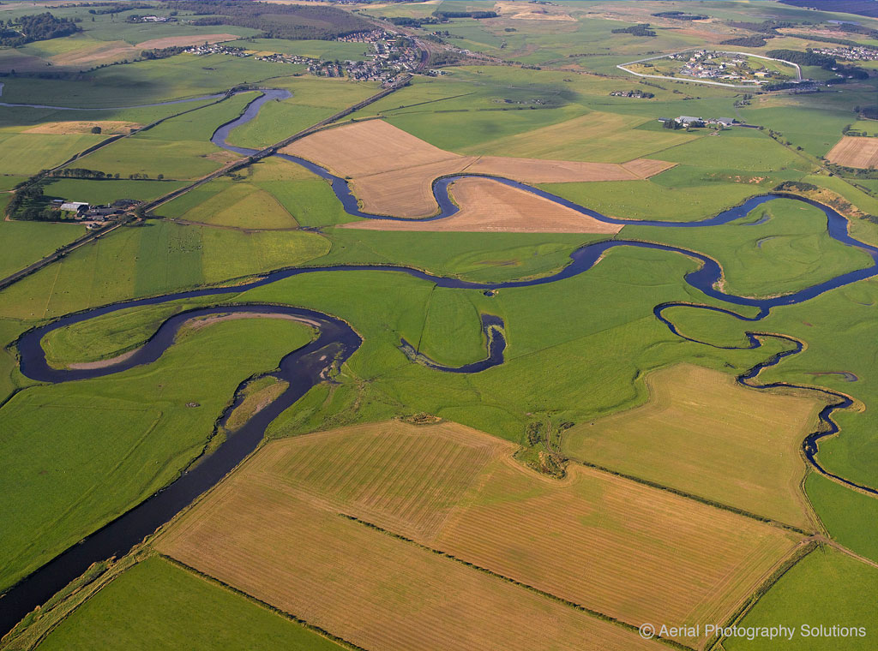

Slide 14
https://www.youtube.com/watch?v=rR_wV9kLAKw

