Slide 1
Introduction to Weather and Climate

Slide 2
Weather vs. Climate
Weather
Climate
Changing conditions of the atmosphere that are experienced day to day and from month to month.
Characteristic patterns of weather experienced year to year in a particular area.
Includes average temperature and precipitation.
Notes:
When we study weather trends and changes in climate, we examine: temperature, winds and air pressure, precipitation

Slide 3
Climate Controls
Factors that play a key role in influencing climatic conditions like temperature.
These factors are closely linked and interdependent.

Slide 4
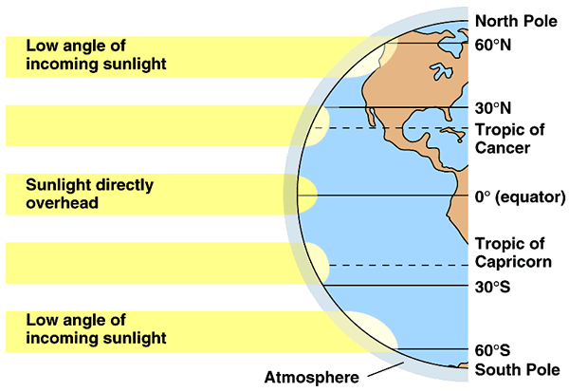
1. Latitude:
- Latitude controls both the angle at which the sun’s rays strike and the duration of the period of daylight → determine that amount of insolation received.
Notes:
Insolation: amount of incoming solar radiation. In general as latitude increases → average temperature decreases and annual temp has a greater range.

Slide 5
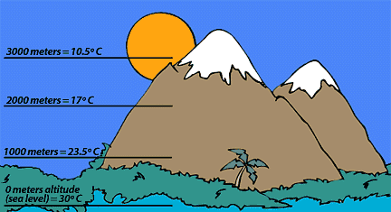
2. Altitude:
As one ascends the temperature drops b/c incoming UV rays are reflected and absorbed by the earth → air cools as it rises.
As altitude increases, temperature decreases.
Average lapse rate: for every 1000m → temperature drops 6.5 degrees C.
Notes:
As you climb a mountain, you can expect the air temperature to decrease by 6.5 degrees C for every 1000 meters you gain. This is called the standard (average) lapse rate or 1 degree for 150m

Slide 6
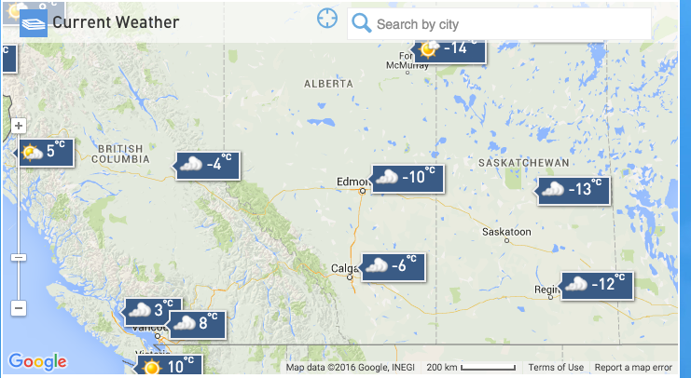
3. Distribution of land and water
- Land and water heat and cool at different rates.
Water heats slowly, but retains heat for a long time vs. land heats and cools rapidly.
This creates: maritime climates in places close to the ocean and continental climates in places far inland.

Slide 7
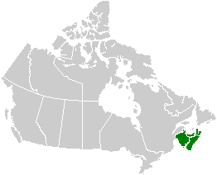
4. Prevailing Winds:
Winds from oceans will bring mild temperatures and winds from land will bring extreme cold or hot temperatures.
Notes:
Winds blowing from the south will be warm vs. winds from the north that are cold. Winds blowing west from land that move to the coast will still decrease temp in maritime region.

Slide 8
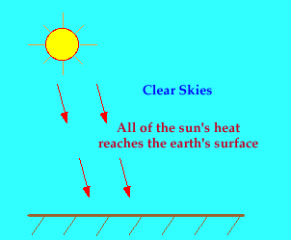
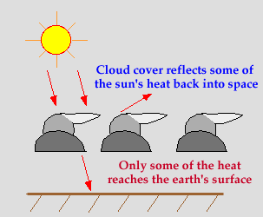
during the day:
5. Clouds:
Notes:
During the day, the earth is heated by the sun. If skies are clear, more heat reaches the earth's surface (as in the diagram below). This leads to warmer temperatures. if skies are cloudy, some of the sun's rays are reflected off the cloud droplets back into space. Therefore, less of the sun's energy is able to reach the earth's surface, which causes the earth to heat up more slowly. This leads to cooler temperatures. Heavy rainfall and prolonged cloudiness prevent sun’s rays from having a full effect on the earth.
Lack of clouds → loss of heat at night

Slide 9
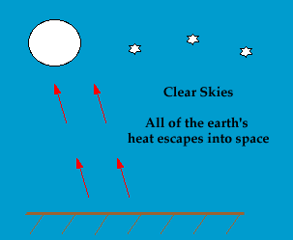
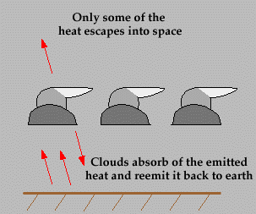
at night:
Notes:
if clouds are present, some of the heat emitted from the earth's surface is trapped by the clouds and reemitted back towards the earth. As a result, temperatures decrease more slowly than if the skies were clear. When forecasting nighttime temperatures, if cloudy skies are expected, forecast warmer temperatures than you would predict if clear skies were expected.

Slide 10
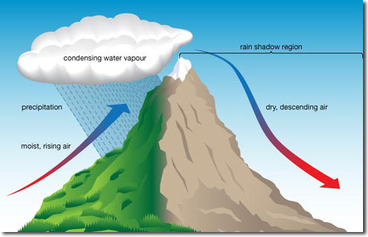
6. Mountain Barrier
Mountains create moist areas on windward side and dry areas on the lee ward side creating a rain shadow.

