Slide 1
Groundwater
Unit 4: Gradational Processes
Ms. Thind

Slide 2
What is groundwater?
fresh water (from rain or melting ice and snow) that soaks into the soil and is stored in the tiny spaces between rocks and particles of soil.
can stay underground for hundreds of thousands of years, or it can come to the surface and help fill rivers, streams, lakes, ponds, and wetlands.
can also come to the surface as a spring or be pumped from a well.
Both of these are common ways we get water for municipal, domestic, and agricultural purposes.
Notes:
BC: 29% of population using groundwater for domestic purposes. In Canada over 8.9 million people rely on it for domestic use. 30% of worlds freshwater is in the ground.
https://classzone.com/books/earth_science/terc/content/investigations/es1401/es1401page04.cfm

Slide 3
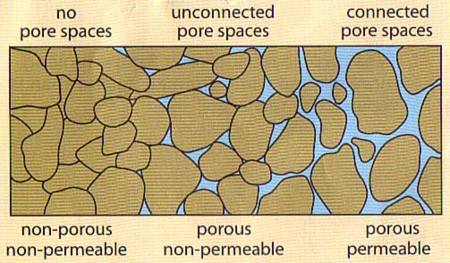
Groundwater
Groundwater is dependent on the permeability and porosity of rock layers.
Permeability: refers to how fast water can pass through rock layers.
Porosity: refers to the portion of open spaces in the soil material.
Notes:
Permeability through the rock, porosity → open spaces, the empty spaces that water can work around to make it to the zone of saturation. Depends on size and shape of rock. Limestone: flat → does not allow water to flow through but round shaped like gravel has high porosity. Well sorted → high porosity and poorly sorted → low porosity. Two separate characteristics of rocks control how effective they are as aquifers:

Slide 4
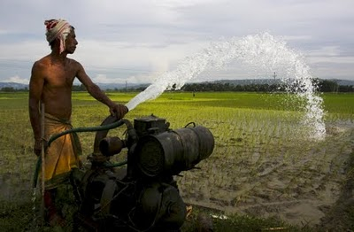
Importance of groundwater
Areas with no mountain ranges rely on groundwater for their water source if rainfall is inadequate.
In the prairies groundwater is used extensively for crop irrigation.
Can you think of other reasons?

Slide 5
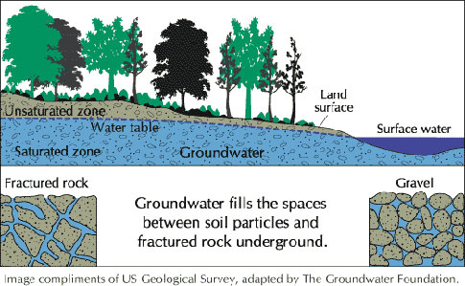
Groundwater zones:
When water infiltrates the ground a section of rock becomes saturated → zone of saturation → this is the groundwater.
The top of the saturated rock/soil is the water table.
The portion of rock that is not 100% saturated is called the zone aeration.

Slide 6
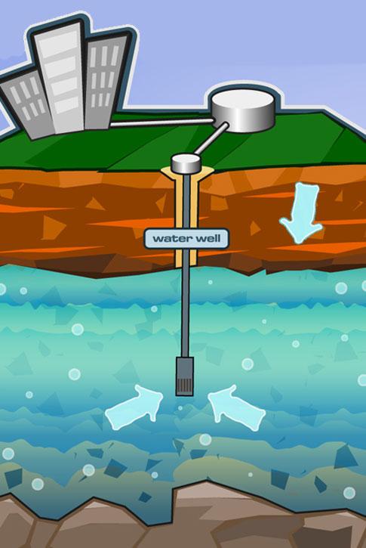
What is an aquifer?
Rock layer that can store and yield water.
In dry areas aquifers provide clean water for drinking and irrigation by drilling a well.

Slide 7
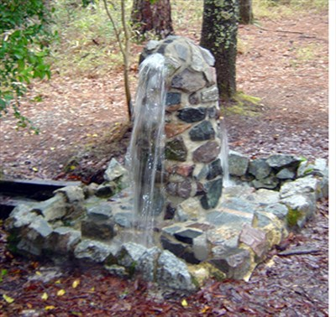
Aquifers: Wells
Artesian Well
Well drilled through the ground
Confined between two impermeable rock layers which causes a build up of pressure → water will rise on its own.
Notes:
Water is under pressure so when a well is drilled into the rock layer it comes to the surface under its own pressure.

Slide 8
Aquifers: Wells
Ordinary Wells:
Located in-between permeable rock.
Water is not under pressure and is forced to rise with a pump.
Notes:
Pollutants can seep with the water and this aquifer and the ordinary well water source could be contaminated by local sources.

Slide 9
Landforms created by groundwater
Travertine Terraces:
Layered deposits of rock
Found in areas where there is an abundant amount of hot groundwater.
Hot water carries dissolved material and when it reaches the surface it quickly cools and deposits minerals on existing rock.
http://www.atlasofwonders.com/2012/11/travertine-terraces.html
Notes:
Hot water can readily dissolve minerals and carry them away in solution. Hot groundwater comes to the surface it cools quickly and can no longer hold the dissolved minerals and forms layers of mineral deposits.

Slide 10
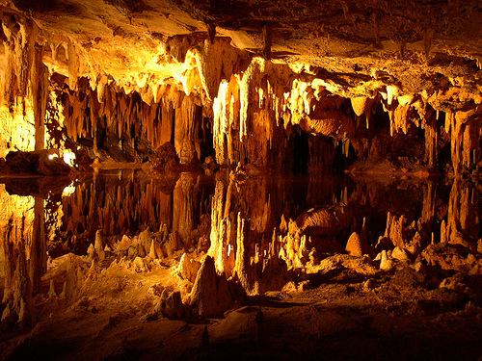
Caves or Caverns:
Found in areas of underlain of limestone
Water moves through rock, it can dissolve limestone.
Notes:
As caverns increase in size the ground above could often collapse.

Slide 11
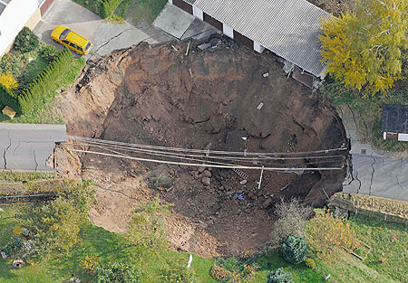
Sinkholes:
As caverns increase in size the overlying support diminishes and the ground collapses → forms a depression → sinkhole.

Slide 12
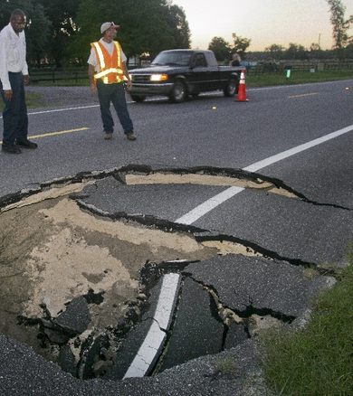
Florida: Why so many sinkholes?
Bulk of Florida peninsula is made up of carbonate rock (limestone and dolostone) overlain by sand and clay.
Carbonate rocks may dissolve (solution) forming karst terrain.
Notes:
Cause? Heavy rain, tropical storms, heavy pumping of groundwater, extensive drilling, and excavation. 6,694 sinkhole-related claims

Slide 13
https://www.youtube.com/watch?v=tQvv8YFCGsY

Slide 14
Key Terms use pgs. 145-149
Permeability
Porosity
Zone of saturation
Zone of aeration
Water table
Ordinary well
Artesian well
Aquifer
Cave or cavern
Travertine terraces
Sinkhole

