Slide 1
Earthquakes!

Slide 2
http://video.nationalgeographic.com/video/101-videos/earthquake-101?source=searchvideo
Notes:
50 earthquakes/ day

Slide 3
What are earthquakes?
When stress-deformed rocks break or release pressure by a sudden shift of position, severe shaking on the ground may occur.
The shaking is caused by seismic waves.
Notes:
Seismic waves originate at the location where the fracture and resulting sudden shift in the rock occurred.

Slide 4
Causes of earthquakes
As plates move and grind against one another, enormous stress is put on the earth’s crust → cracks or faults form.
Movement at these faults are not smooth.
Pressure may build for a long time → when pressure is too great and the rock suddenly moves, it releases this stored energy.

Slide 5
Where do earthquakes occur?
Notes:
Occur along fault lines: divergent, transform, and convergent boundaries.

Slide 6
http://earthquake.usgs.gov/earthquakes/world/10_largest_world.php

Slide 8
Earthquakes
Exact point in the earth where rock fracture occurs is known as the focus.
The epicenter is the point on the earth’s surface directly above the focus.
Focal depth: distance between the focus and epicenter.
Notes:
From the epicenter is where the energy is dispersed and spreads across the surface. Focus can vary in depth and can be about 700km at locations where plate is diving into the mantle.

Slide 9
Notes:
Shallow earthquakes are between 0 and 70 km deep and deep earthquakes. In general, the term "deep-focus earthquakes" is applied to earthquakes deeper than 300-700. Shallow: smaller magnitudes, close to surface, along different boundaries, often go unnoticed. Deep: mostly along subduction zones, friction is great, great magnitude and energy released.

Slide 10
How do we measure Earthquakes?
Notes:
Richter scale: used to quantify the energy released by an earthquake. Developed in the 1930s, based on a 10 point scale. Earthquakes are measured by a seismometer: at each point on the richter scale or ten times that of an earthquake below. It used a formula based on amplitude of the largest wave recorded on a specific type of seismometer and the distance between the earthquake and the seismometer.

Slide 11
Earthquake Hazards
Ground Motion: damage to buildings, bridges, dams, gas line ruptures, etc.
Aftershocks: secondary earthquakes can cause additional damage to weakened structures.
Landslides: failure of slopes causing downward movement of rock and debris
d) Fires
e) Tsunamis: waves generates by sudden movement on the sea floor.
Notes:
Aftershocks can continue several days after the earthquake.

Slide 13
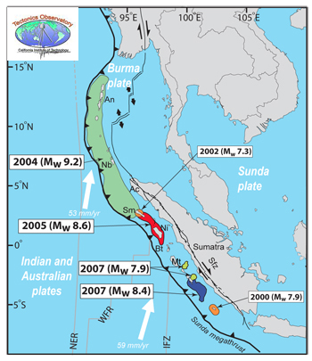
Sumatra Earthquake Dec 26th, 2004
Notes:
1200 km of fault line slipped 15 meters along subduction zone where the indian plate dives below the burma plate. This powerful earthquake was centered about 160km west of northern Sumatra, Indonesia. 9.1 magnitude → 3rd largest earthquake → shifting of plates resulted in the creation of new ridges along the ocean floor → displacement created tsunami waves that struck 18 nations. 200,000 – 400,000 people died, over 100,000 missing. Tsunami warning system did not exist.

Slide 14
https://www.youtube.com/watch?v=PDFRMupRhso

